Slide 1

Evaluating Algorithmic Fairness:
A Comparative Audit of Machine Learning Models in Loan Approval System
Esha Agarwal
GH1031345

Slide 2

Introduction & Motivation
The financial sector is increasingly adopting AI. However, "black box" algorithms pose ethical risks regarding protected features like gender.
Protected Features/Sensitive Attributes: The feature that may induce bias towards human and/or algorithms
Black Box Algorithm: A system that produces an output from an input without revealing how it reached that conclusion
Management Problem
Financial institutions pose a risk of regulatory non-compliance & reputational damage if, their loan approval algorithms exhibit disparate impact.

Slide 3
Literature Review
This literature review conducted over key academic contributions relevant to algorithmic fairness in machine learning models, particularly within financial decision-making processes.
Author & Year
Theme
Relevance
Mehrabi et al. (2021)
Bias Origins
Algorithms often inherit "historical bias" from training data. If past loan officers discriminated, the model learns to do the same.
Dutta et al. (2020)
The Trade-off
There is often an inherent tension between maximizing Accuracy and maximizing Fairness. Increasing one frequently degrades the other.
Zafar et al. (2017)
Fairness Metrics
Defined "Disparate Mistreatment" (error rate differences) as a critical metric for decision boundaries in sensitive domains.
Sudhakar et al. (2020)
Model Comparison
Random Forest consistently outperforms Logistic Regression in pure accuracy but suffers from "Black Box" opacity, making it harder to audit for bias.
Fig: Relevant Literature

Slide 4
Research Objectives & Questions
Research Gap
Objectives
The direct, comparative audit of three specific models (SVM, RF, and LR) focused on their performance on financial data across “Disparate Impact” & “Disparate Mistreatment”.
To audit 3 distinct models (SVM, RF, LR) for fairness.
Questions
Definitions
Does historical loan data already contain gender bias?
SVM - Support Vector Machine, Steinwart & Christmann, 2008.
Which classification algorithm (SVM, RF, or LR) has the least unfair errors: “Disparate Impact” & “Disparate Mistreatment”?
RF - Random Forest, Breiman, L. Random Forests. Machine Learning 45, 5–32 (2001).
LR - Logistic Regression, King and Zeng, 200

Slide 5
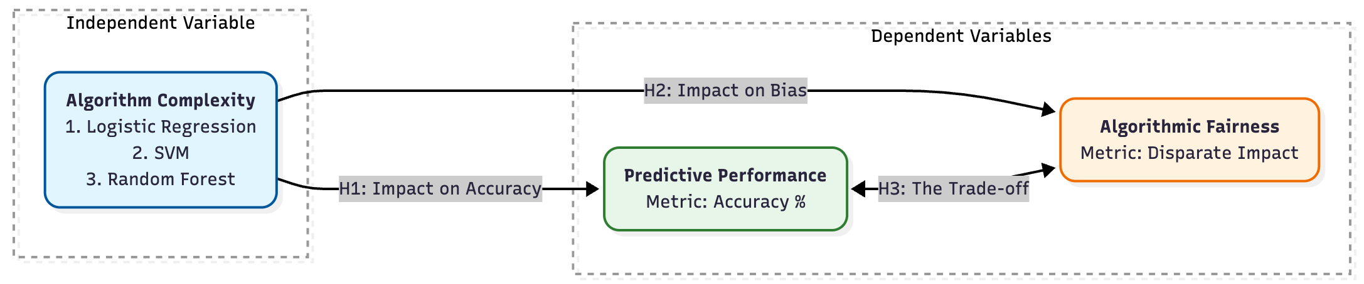
Conceptual Framework
Hypotheses:
H1 (Impact on Accuracy):
How does the model choice impact its accuracy?
H2 (Impact on Bias):
How does the model choice impact its fairness?
H3 (The Trade-off):
Represents the tension between maximizing accuracy and maximizing fairness.

Slide 6
Methodology
Quantitative Experimental Design
Data Source
Fairness Metrics
Comparison of 3 Classification Machine Learning Models
Secondary Data Available openly on Kaggle
"Disparate Impact" & "Disparate Mistreatment" (accuracy gaps)
Fairness Metrics Details
Metric 1: Disparate Impact (Statistical Parity)
Definition: The ratio of the probability of a positive outcome (Approval) for the protected group vs. the unprotected group.
Threshold: The "80% Rule" (legal standard in US employment/lending).
Metric 2: Disparate Mistreatment (Predictive Equality)
Definition: The difference in Accuracy between groups.
Relevance: Ensuring one group is not "wrongly denied" more often than another.
Data Collection
Secondary data sourcing from a public repository (Kaggle), utilising 2,000 loan application records
7 features and 1 binary target variable

Slide 7
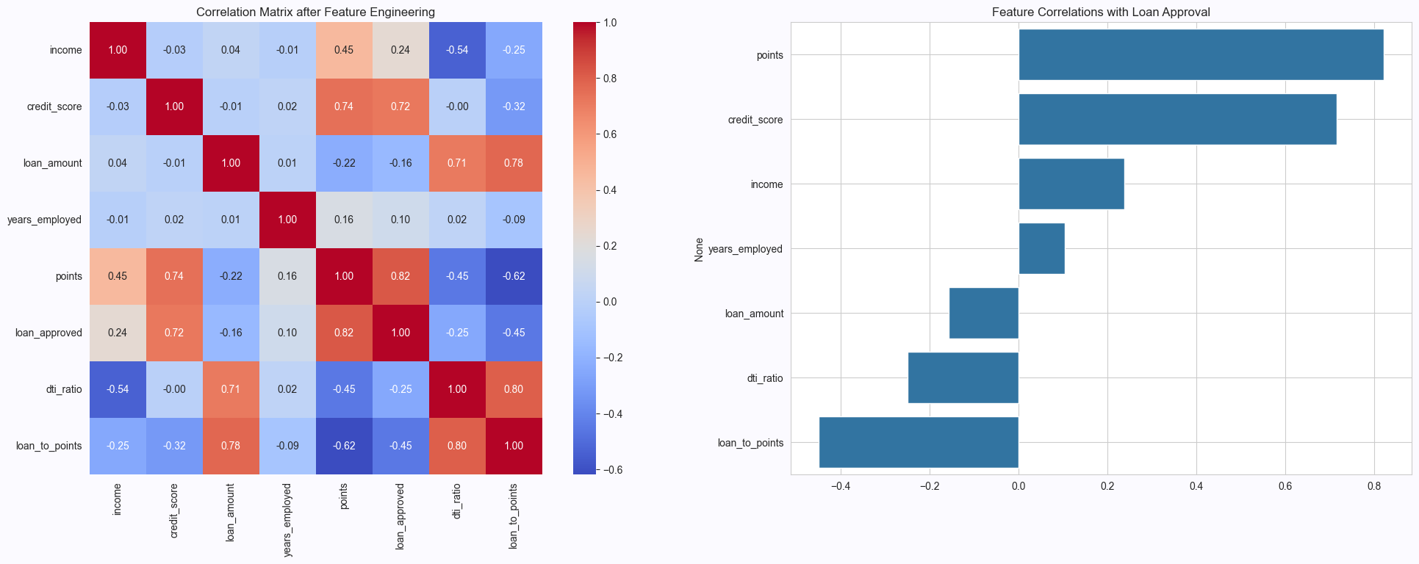
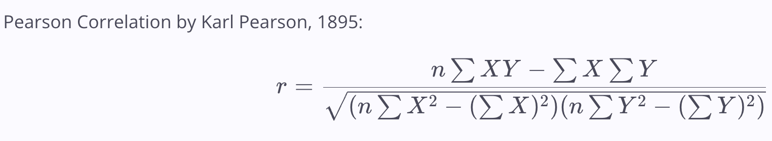
Results
Preliminary Test – Correlation Matrix
Pearson Correlation by Karl Pearson, 1895:
Challenge-1:
Potential Data Leakage: The feature ‘points’ is a cause for potential data leakage
because it is not present at the time of approval but rather assigned after loan process.

Slide 8
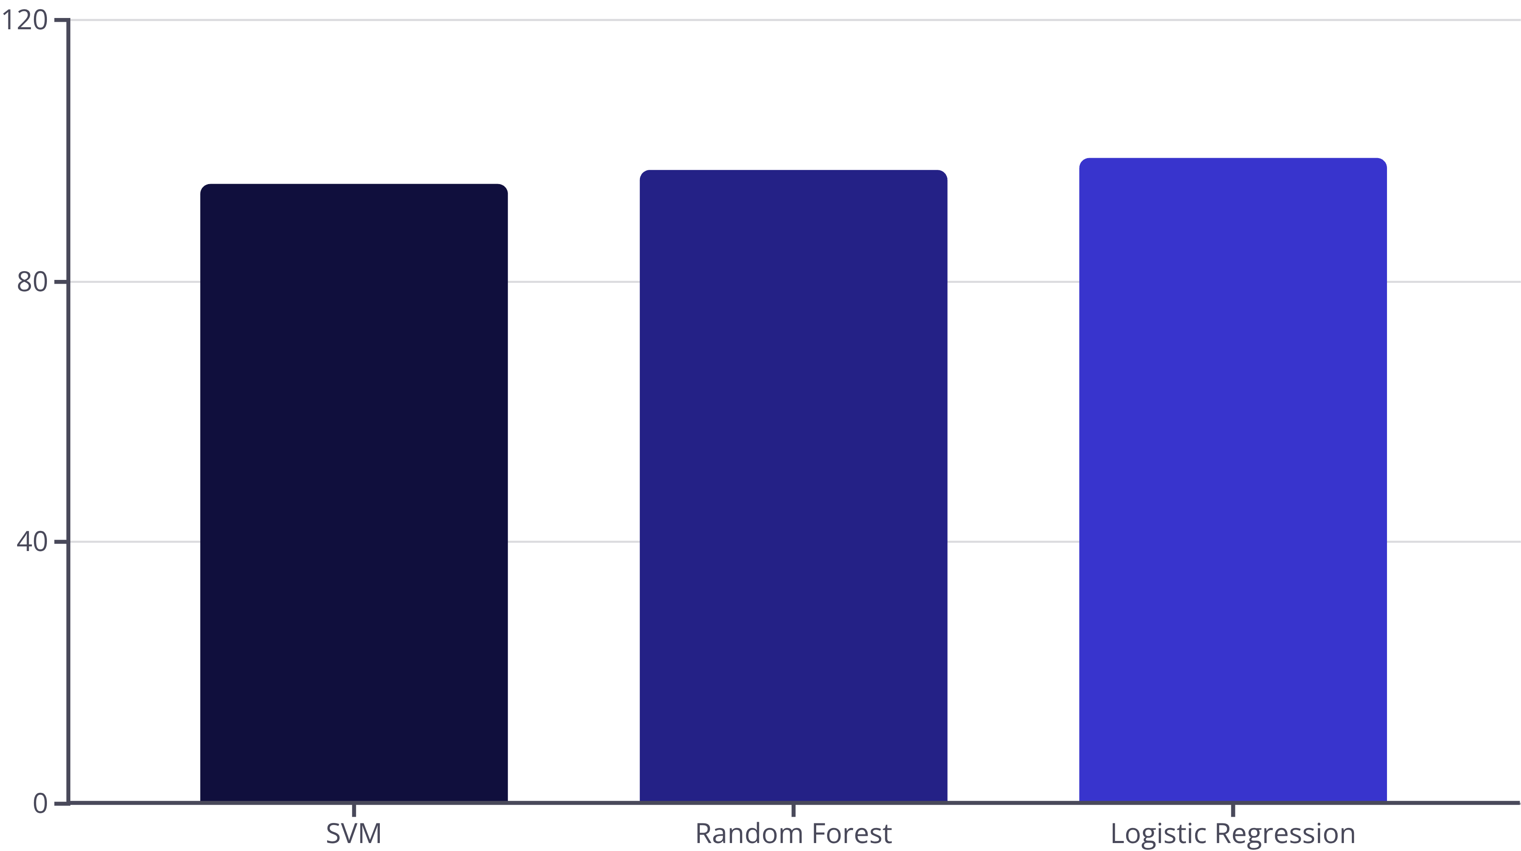
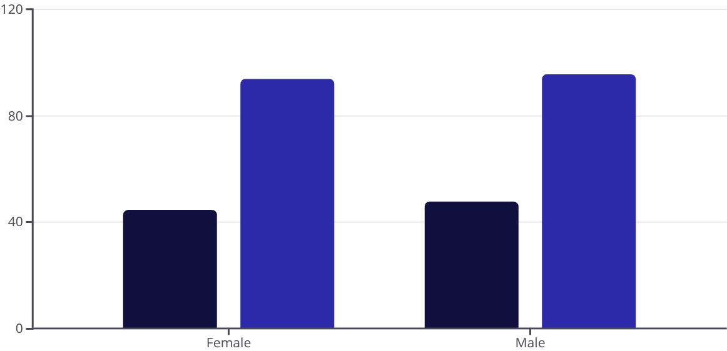
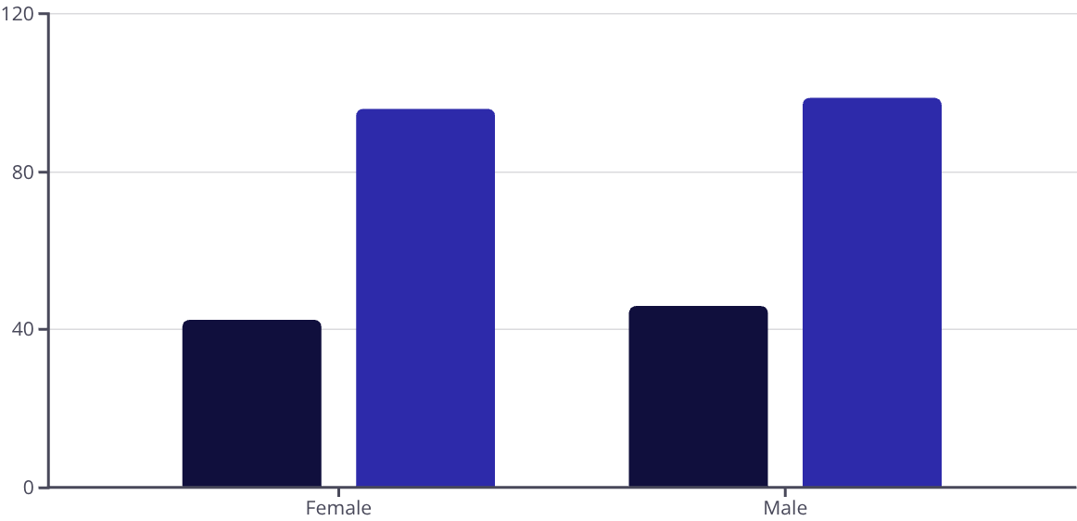
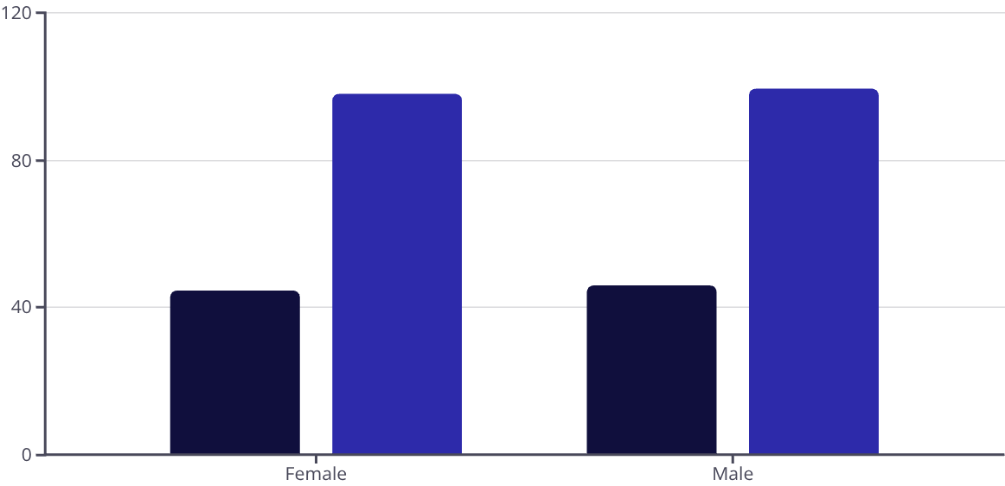
Results
Predictive Findings
Overall Accuracy Comparison
Fairness Audit
SVM – 95% RF – 97% LR – 99%
The "Disparate Mistreatment on Accuracy" is the difference in Accuracy between Males & Females.
The "Disparate Impact” is the difference in Approved % between Males & Females.
Logistic Regression demonstrated the smallest gap in both cases.
Disparate Impact & Disparate Mistreatment on Accuracy
SVM
Random Forest
Logistic Regression
Approved (%)
Accuracy (%)

Slide 9
Research Findings
Questions
Does historical loan data already contain gender bias?
A. Yes, historical loan data does contain a minimal gender bias in this dataset.
Which classification algorithm (SVM, RF, or LR) has the least unfair errors: “Disparate Impact” & “Disparate Mistreatment”?
A. LR outperforms RF and SVM in terms of fairness and overall accuracy because the relation of features and target was simple. Which is different than Sudhakar et al. (2020) who found RF to outperform LR but harder to interpret.

Slide 10
Conclusion & Recommendations
Based on this complete analysis, the Logistic Regression model is the clear winner for this business problem.
Performance
Fairness
It achieved the highest overall accuracy at 99%.
It demonstrated the lowest bias across both fairness metrics, showing the smallest gap in both approval rates (Disparate Impact) and error rates (Disparate Mistreatment).
Recommend Logistic Regression for this specific use case but advise human oversight for the 1.59% error gap.
Further work could involve bias mitigation techniques, such as re-weighting the samples or using a different fairness-aware algorithm.

